Slide 1
Logistics Management
Group Name – G2
Team Members-
Abhishek Malpedi - GL
Subhashree Rath
Snehal Chaudhari
Priyanka Aphale
Ajit Paygude
Venkatesan Mayilsamy

Slide 2
Introduction
Logistics management is the part of supply chain management that plans, implements and controls the efficient, effective forward , and reverse flow and storage of goods, services, and related information between the power of origin and the point of consumption in order to meet customer’s requirements.

Slide 3
Business Requirements.
User can update his personal details.
User will be able to select product into his cart.
Admin can be able to update his products and dealers for logistics.
Admin can check status for his products for availability.
Admin can check daily sales of products for logistics.

Slide 4
Functional Specifications.
User-
User can login for an existing account or can register for a new account.
While registering for a new account, user-id is auto generated.
User’s minimum age should be 18.
User can update all his/her details except user-id, name and date-of-birth.
User can view products and can select a product into his/her cart for checkout.
User can logout from his/her account from any screen.

Slide 5
While adding product into cart, selected quantity of products must qualify the minimum quantity condition and should be less than the available quantity of product.
User can select maximum 6 products into his/her cart at a time.
Transportation charges will be applicable for each order.
Admin-
Admin has only one account for his logistics.
Admin can update products and dealers for his logistics.
Only one dealer for one product.
If a dealer is deleted from logistics, then products having that dealer is also deleted.
Admin can check status of products for availability and can order that product from dealer.

Slide 6
Technical Specifications.
COMPONENT NAME | TYPE | DESCRIPTION
P24AS01 | BMS Map | Maps for main-menu, login and register.
P24AS02 | BMS Map | Maps for admin-menu, product-dealer updation, status.
P24AS03 | BMS Map | Maps for user-menu, account updation, view product and bill.
P24AP01 | CICS Cobol | Main menu program.
P24AP02 | CICS DB2 | Login program.
P24AP03 | CICS DB2 | Register Program.
P24AP04 | CICS Cobol | Admin menu program.
P24AP05 | CICS DB2 | Product updation program.
P24AP06 | CICS Cobol | User menu program.
P24AP07 | CICS DB2 | Account updation program.
P24AP08 | CICS Cobol | View product and bill generation program.
P24AP09 | CICS DB2 | Dealer updation program.
PROG07 | COBOL DB2 | Report printing program for product status.
PROG08 | COBOL DB2 | Report printing program for daily sales.

Slide 7
COMPONENT TYPE | COUNT
BMS | 3
CICS + Cobol | 4
CICS + DB2 COBOL + DB2 | 5 2

Slide 8
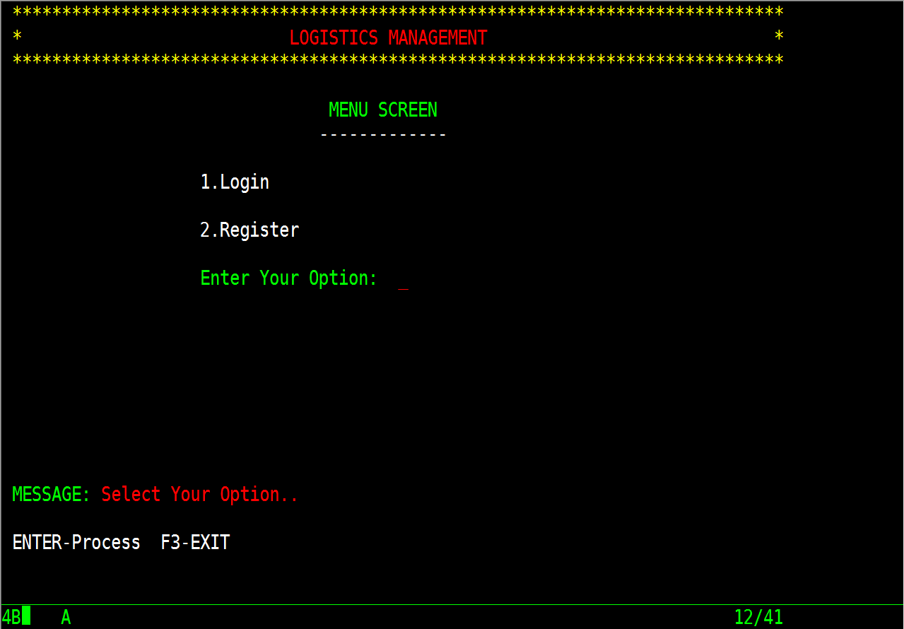
Screens
1. Menu Screen
This is the first home page of the application and has access for following options:
Login for existing user
Register for new user
ENTER – On pressing this aid key, user is directed to respective option.
F3 – On pressing this aid key, user can exit from the application.

Slide 9
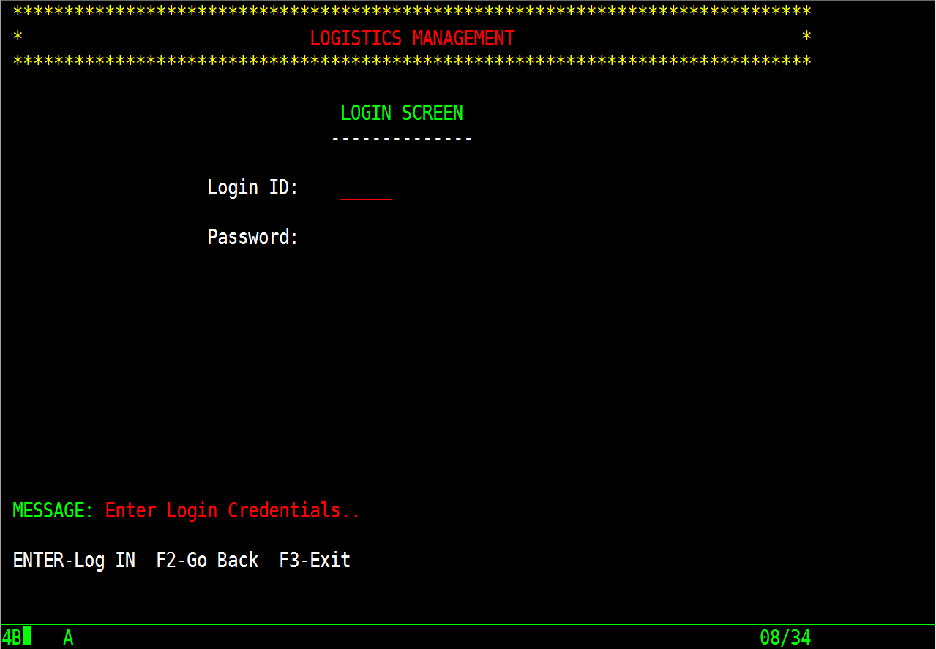
2. Login Screen
If proper details are entered, user is directed to next screen or else invalid message is shown.
ENTER – On pressing this aid key, user can successfully login into his account if entered details are valid.
F3 – On pressing this aid key, user can exit from the application.

Slide 10
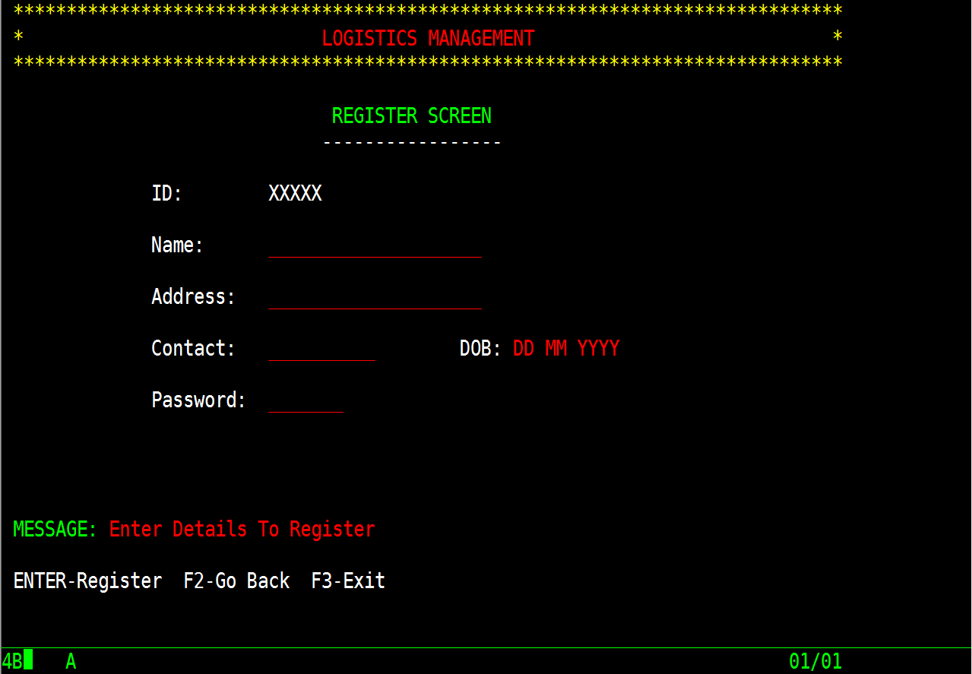
3. Register Screen
User ID is generated automatically for new user.
ENTER – If entered details qualify all the validations, user is registered successfully.
F2 – On pressing this aid key, it will redirect user to main menu screen.
F3 – On pressing this aid key, user can exit from the application.

Slide 11
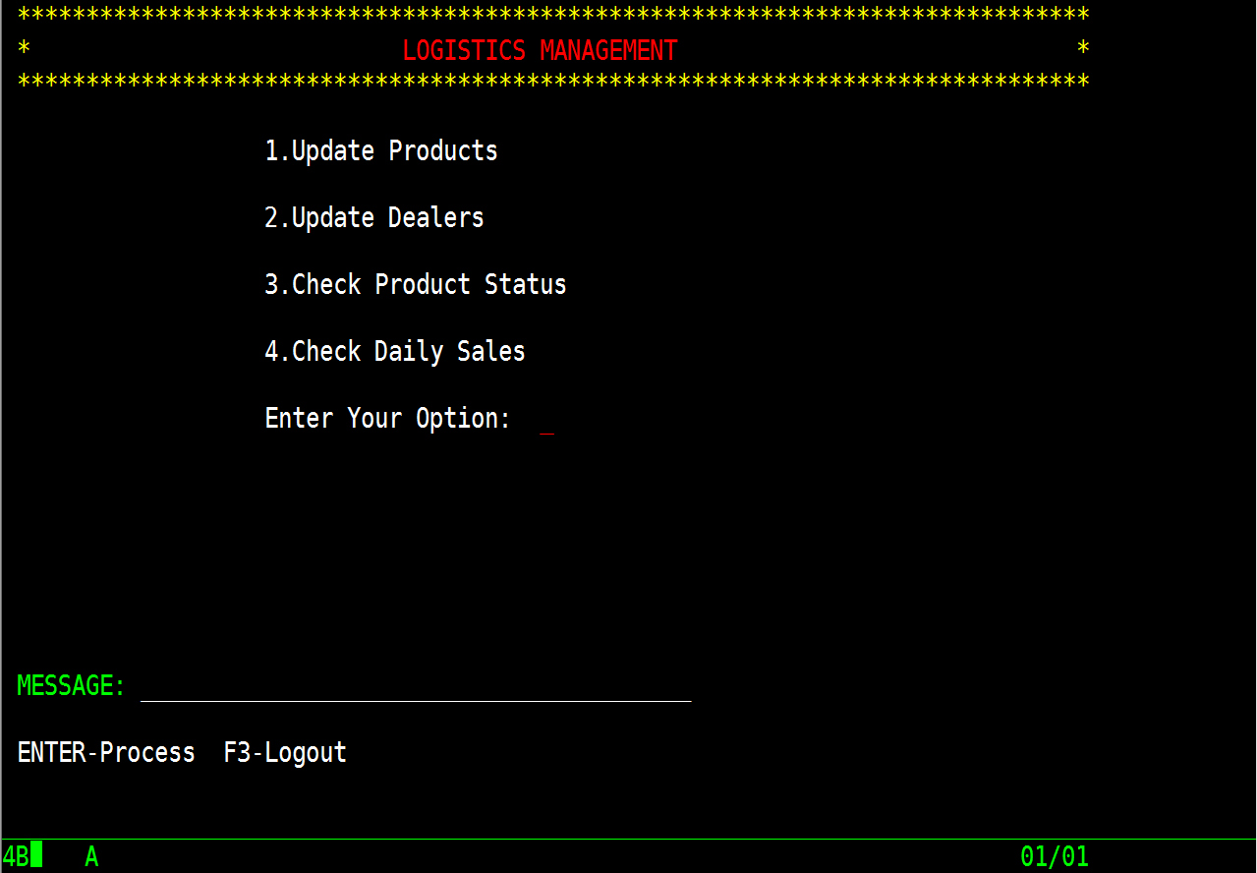
4. Admin Menu
On successful login, admin has access for following options:
Can update products
Can update dealers
Can view product status
Can check daily sales
ENTER – On pressing this aid key, admin can perform respective task.
F3 - On pressing this aid key, admin can logout from this application.

Slide 12
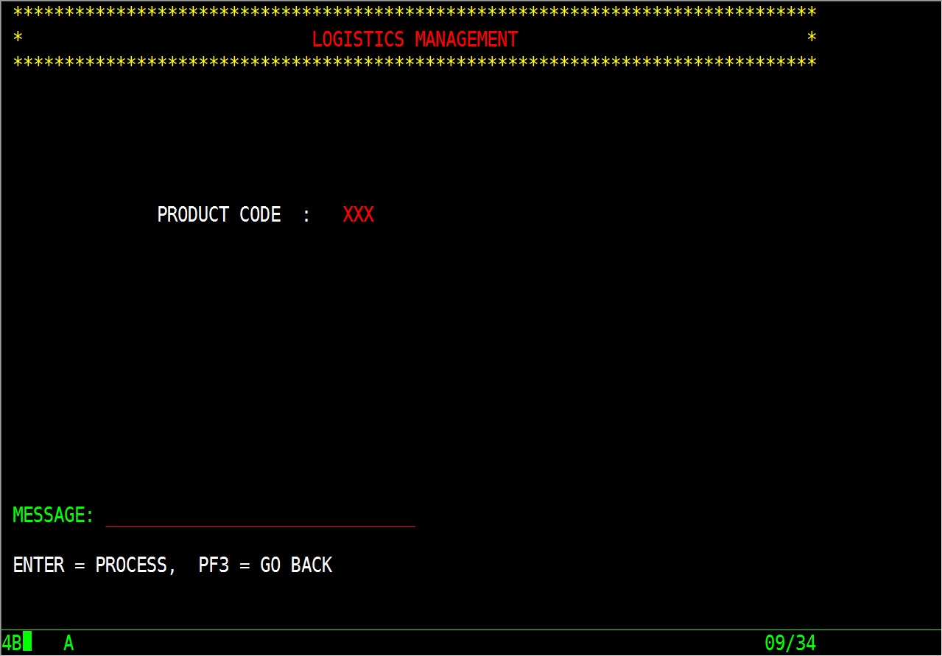
5. Update Product
On entering product ID, admin can add, update and delete products.
ENTER- On pressing this aid key, next map is shown with all the details of existing products.
F3 - On pressing this aid key, admin can logout from this application.

Slide 13
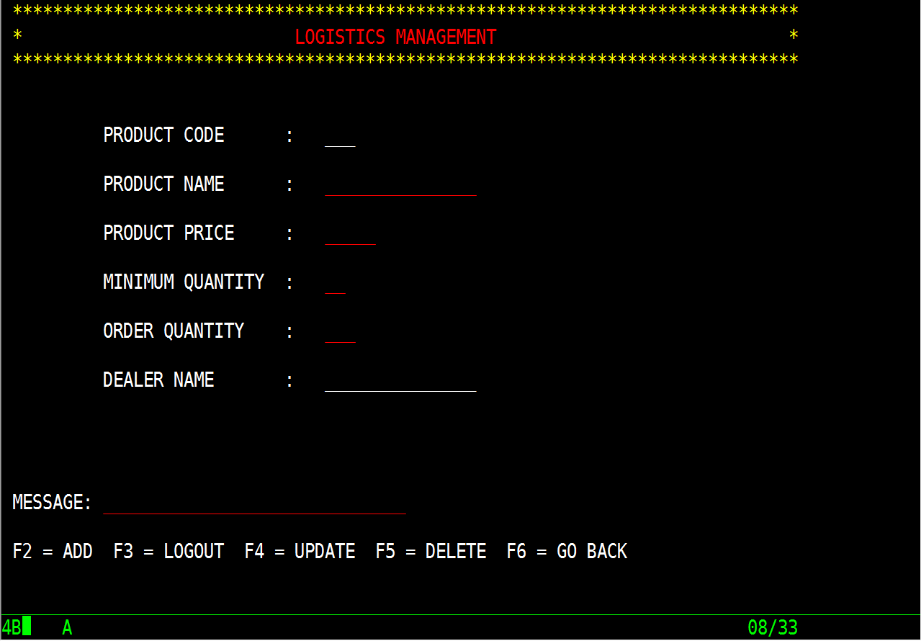
This map shows all the product details for updation. Admin cannot update product ID and respective dealer name.
F2 – This aid key is enabled only for new product ID which adds the new product details.
F4 – This aid key is enabled only for existing product ID which update the product details.
F4 – This aid key is enabled only for existing product ID which delete the product.
F3 - On pressing this aid key, admin can logout from this application.
F6 - On pressing this aid key, admin menu map is shown.

Slide 14
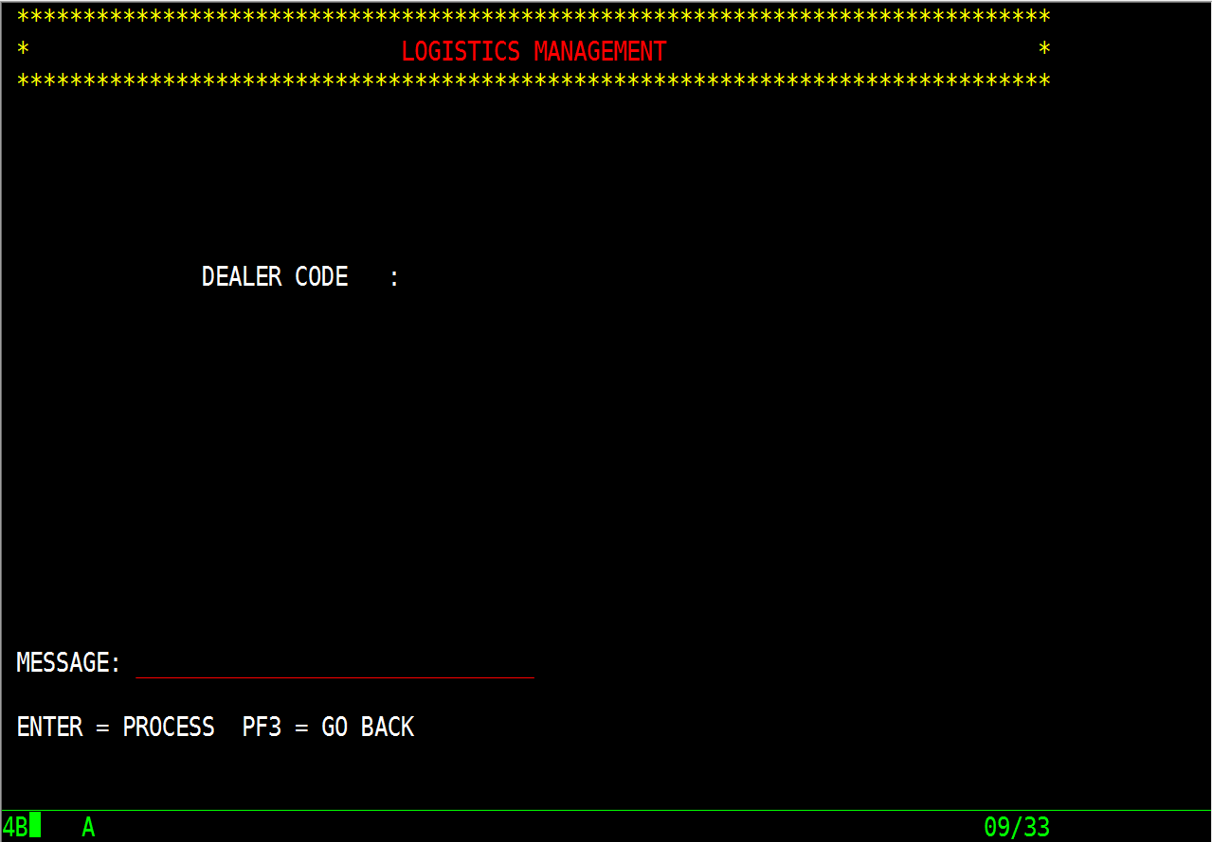
6. Update Dealer
On entering dealer ID, admin can add, update and delete dealer.
ENTER- On pressing this aid key, next map is shown with all the details of existing dealer. If dealer ID doesn’t exists, new dealer is added.
F3 - On pressing this aid key, admin can logout from this application.

Slide 15
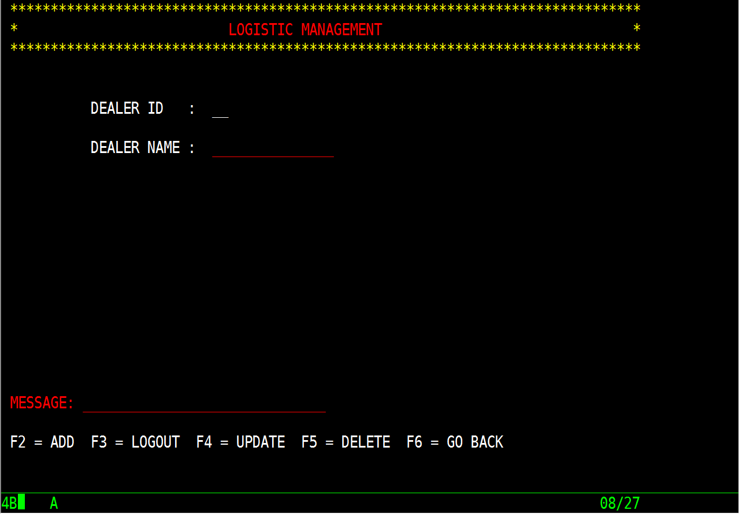
This map shows all the dealer details for updation. Admin cannot update dealer ID.
F2 – This aid key is enabled only for new dealer ID which adds the new dealer details.
F4 – This aid key is enabled only for existing dealer ID which update the dealer details.
F4 – This aid key is enabled only for existing dealer ID which delete the dealer.
F3 - On pressing this aid key, he can logout from application.
F6 - On pressing this aid key, admin menu map is shown.

Slide 16
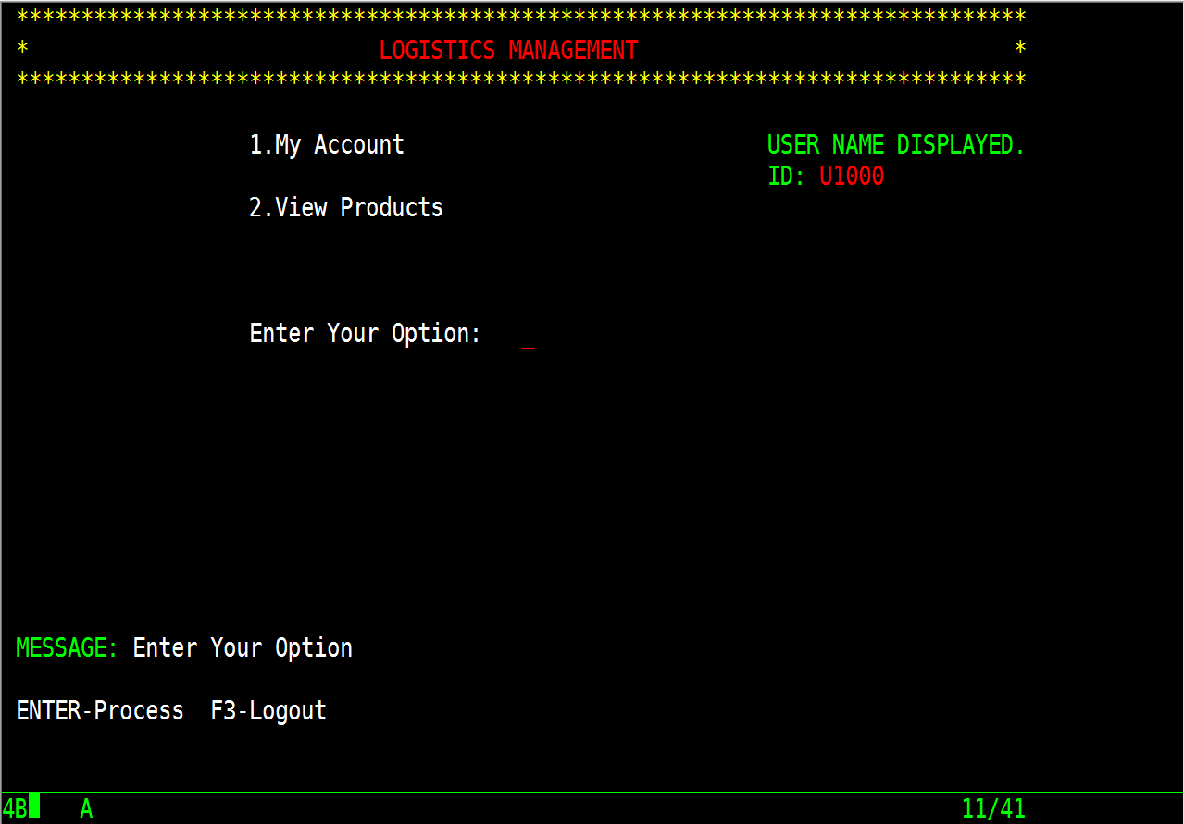
7. User Menu
On successful login, user name and his ID is shown on right side of BMS. User has access for following options:
To update his personal details
To view products and select product into cart
ENTER – On pressing this aid key, user can perform respective task.
F3 - On pressing this aid key, user can logout from this application.

Slide 17
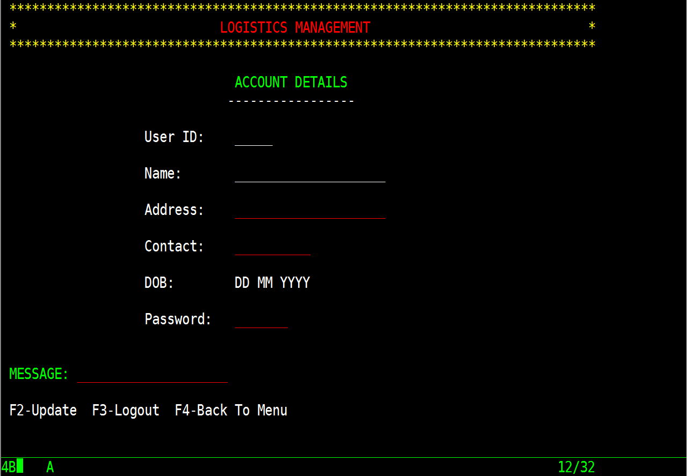
8. Update Account
This map shows all the user details for updation. User cannot update his ID, name and date-of-birth.
F2 – On pressing this aid key, user details are updated after passing the validations.
F3 - On pressing this aid key, user can logout from this application.
F4 - On pressing this aid key, user menu map is shown.

Slide 18
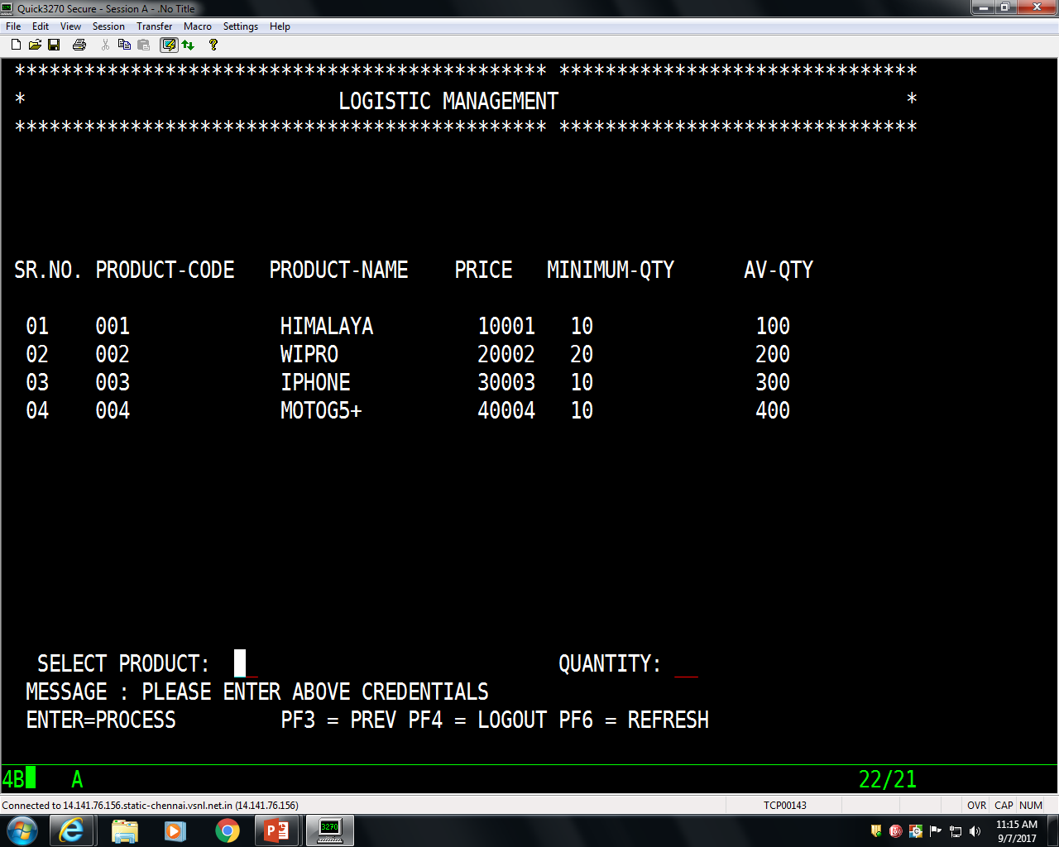
9. View Products
This map shows all the product details with all it’s details to allow user to select product into his cart.
F3 - On pressing this aid key, user can logout from this application.
F4 - On pressing this aid key, user menu map is shown.
F5 – On pressing this aid key, bill is generated for selected product.
F6 - On pressing this aid key, this map is refreshed.

Slide 19
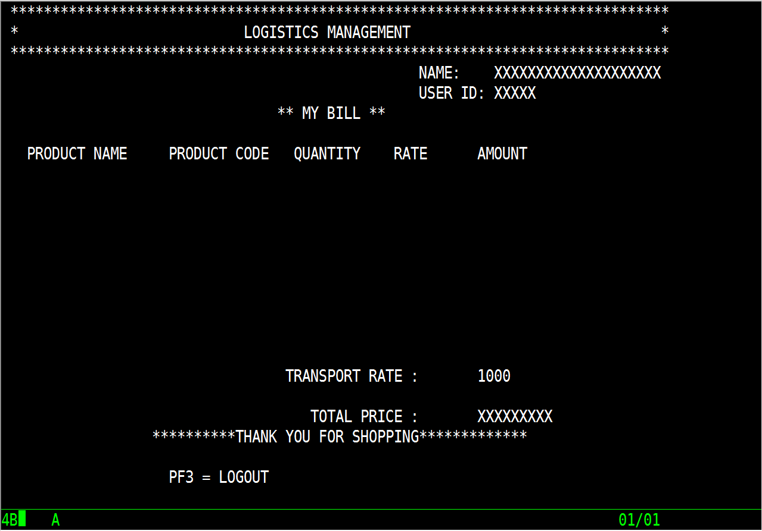
10. Bill
This map shows the selected product into cart and generates bill for user.
F3 - On pressing this aid key, user can logout from this application.

Slide 20
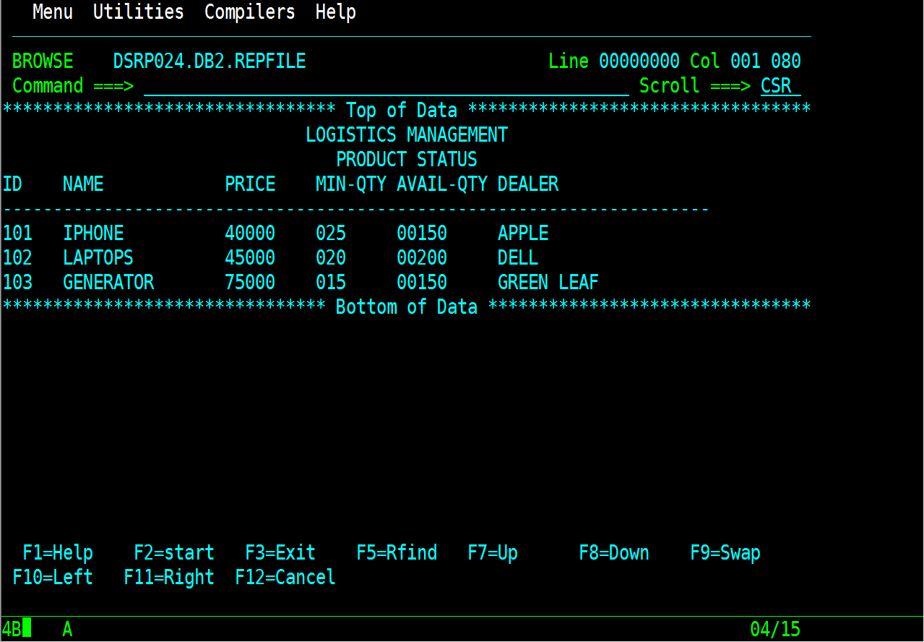
11. Report printing for product status
Admin can generate report file for products to check status of availability of products with its logistics, to check price of that products and to check dealer associated with that product.

Slide 21
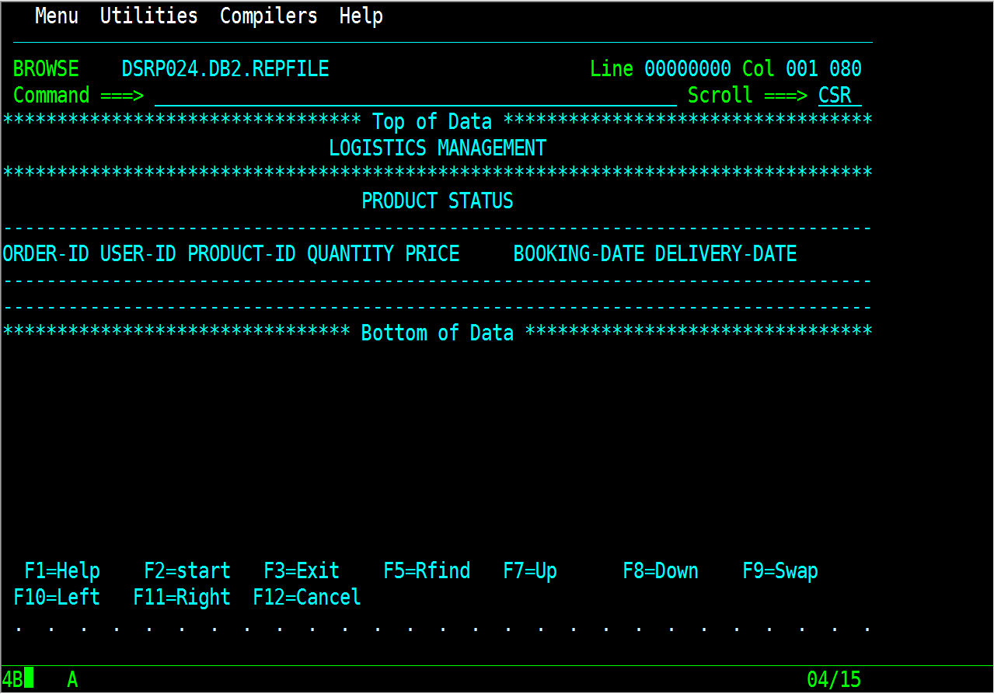
12. Report printing to check daily sales
Admin can generate report file to check daily sales of products. While generating report file, it checks the booking dates of all orders and prints only those orders that were placed today comparing with system-date.

Slide 22
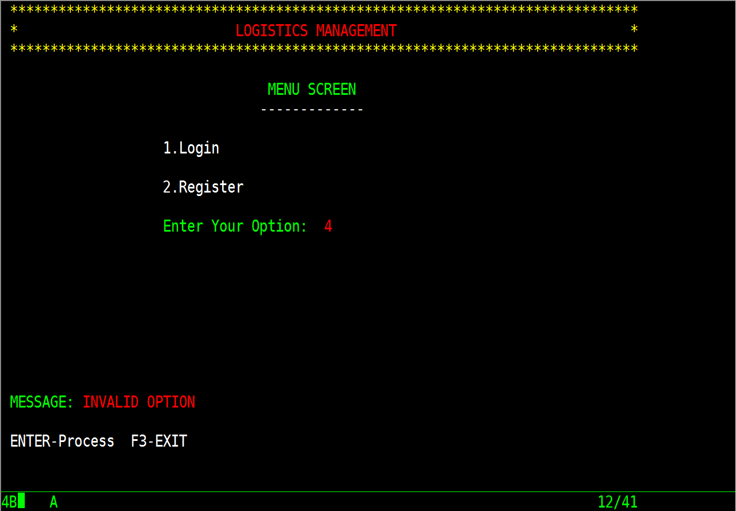
Test Cases
1. Menu Screen
Test Case 1: Invalid Option
Expected result - Invalid option message
Actual result – Displaying invalid option message
Result – PASS
Test Case 2: Valid Option
Expected result – Directing user to next map based to selected option
Actual result - Directing user to next map based to selected option
Result – PASS

Slide 23
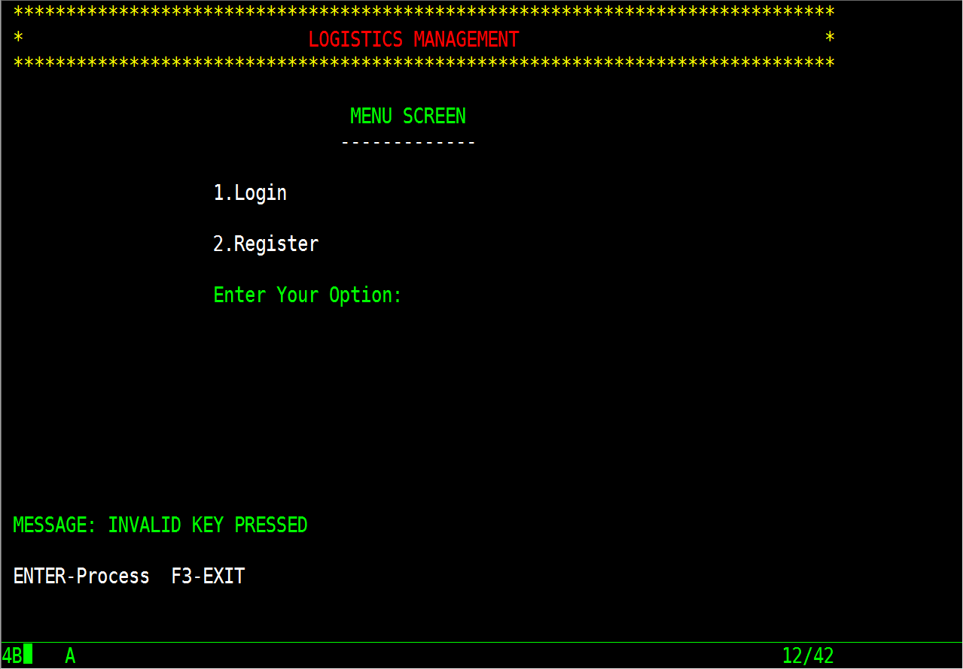
Test Case 3: Invalid AID-Key
Expected result – Display proper message if invalid aid-key is pressed
Actual result – Displaying proper message
Result – PASS

Slide 24
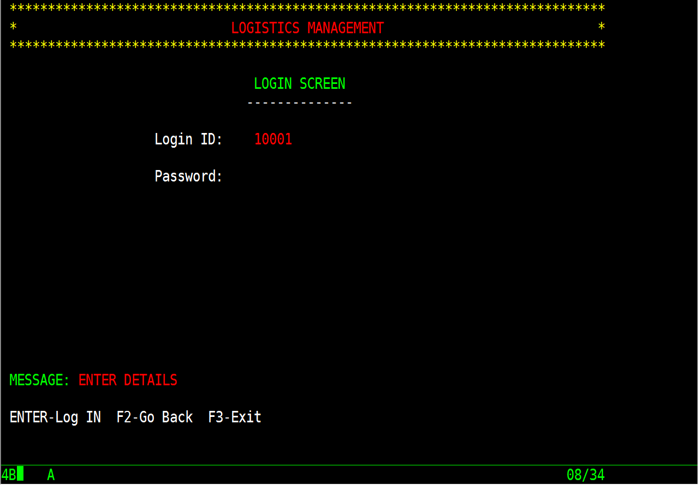
2. Login Screen
Test Case 1: Enter all details
Expected result – Ask user to fill all details
Actual result – Displaying proper message
Result – PASS

Slide 25
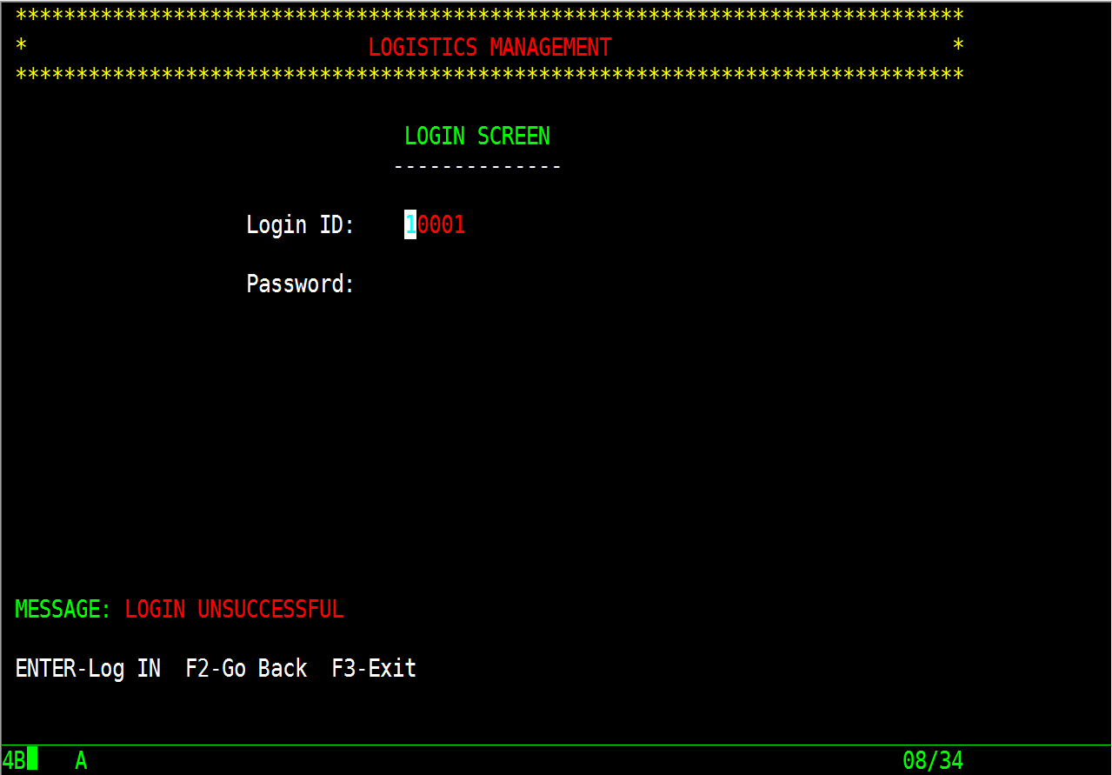
Test Case 2: Check entered details
Expected result – Show login unsuccessful message to user if details are invalid otherwise log IN successfully
Actual result – Displaying proper message for invalid details and login successful for valid details
Result – PASS

Slide 26
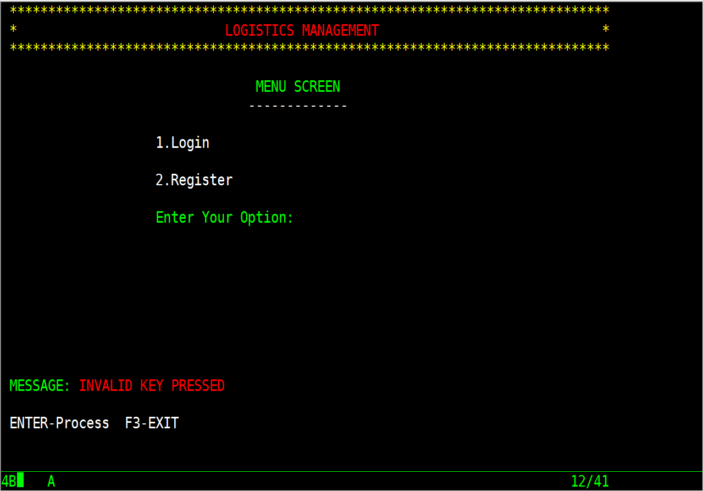
Test Case 3: Invalid AID-Key
Expected result – Display proper message if invalid aid-key is pressed
Actual result – Displaying proper message
Result – PASS

Slide 27
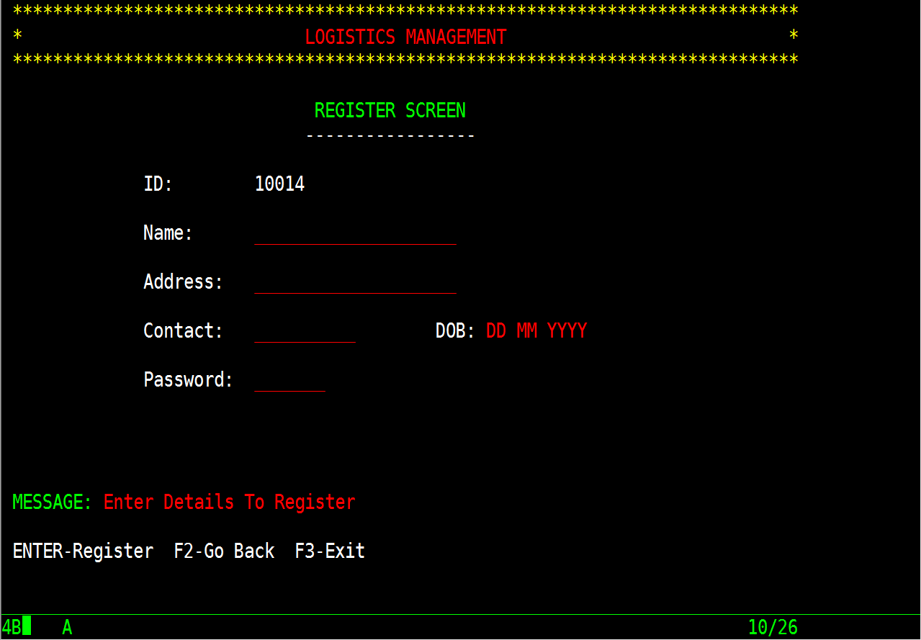
3. Register Screen
Test Case 1: Generating auto ID
Expected result – To generate auto ID for user every time he register a new account
Actual result – Generating auto ID
Result – PASS
Test Case 2: Enter all details
Expected result – Ask user to fill all details
Actual result – Displaying proper message
Result – PASS

Slide 28
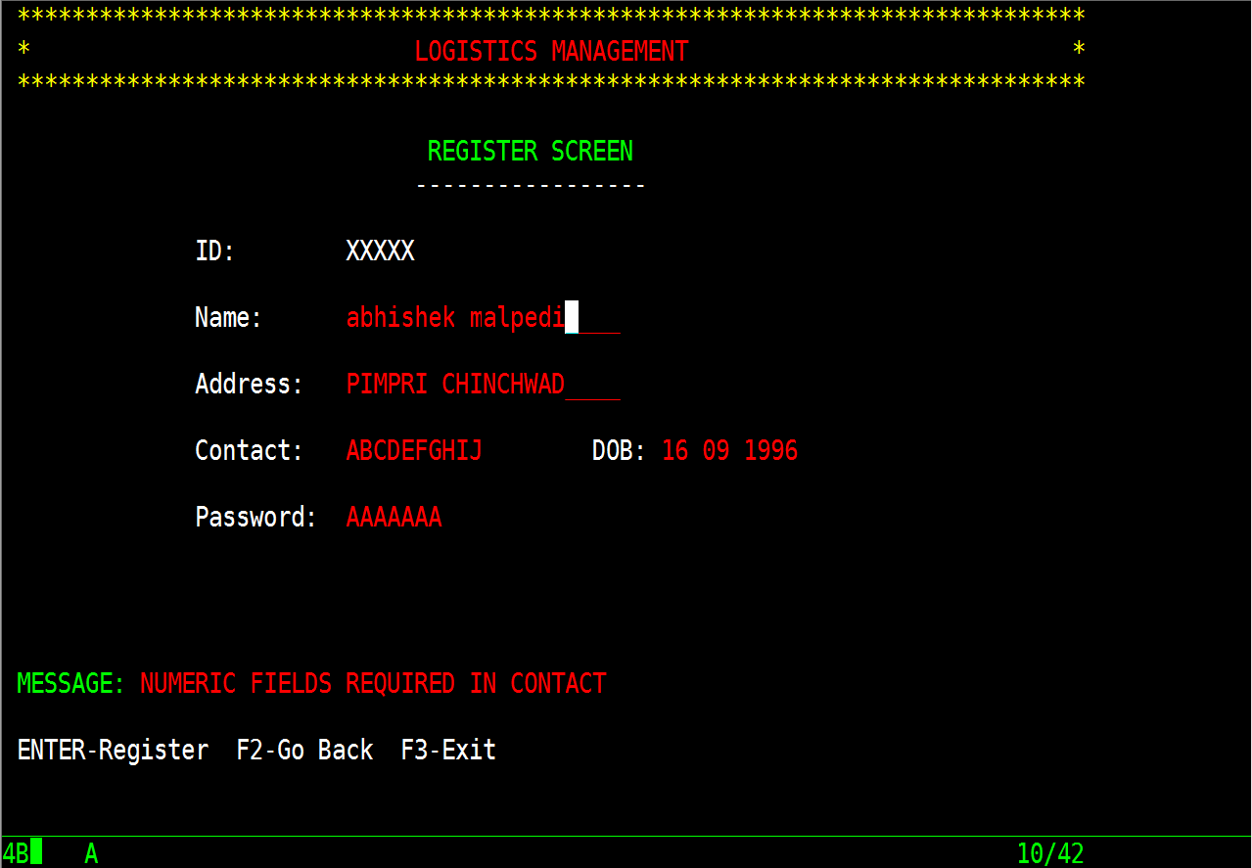
Test Case 3: Contact details must be numeric
Expected result – Proceeding further only when contact details are numeric, else requesting user to enter numeric fields in contact
Actual result – Displaying proper message for invalid details
Result – PASS

Slide 29
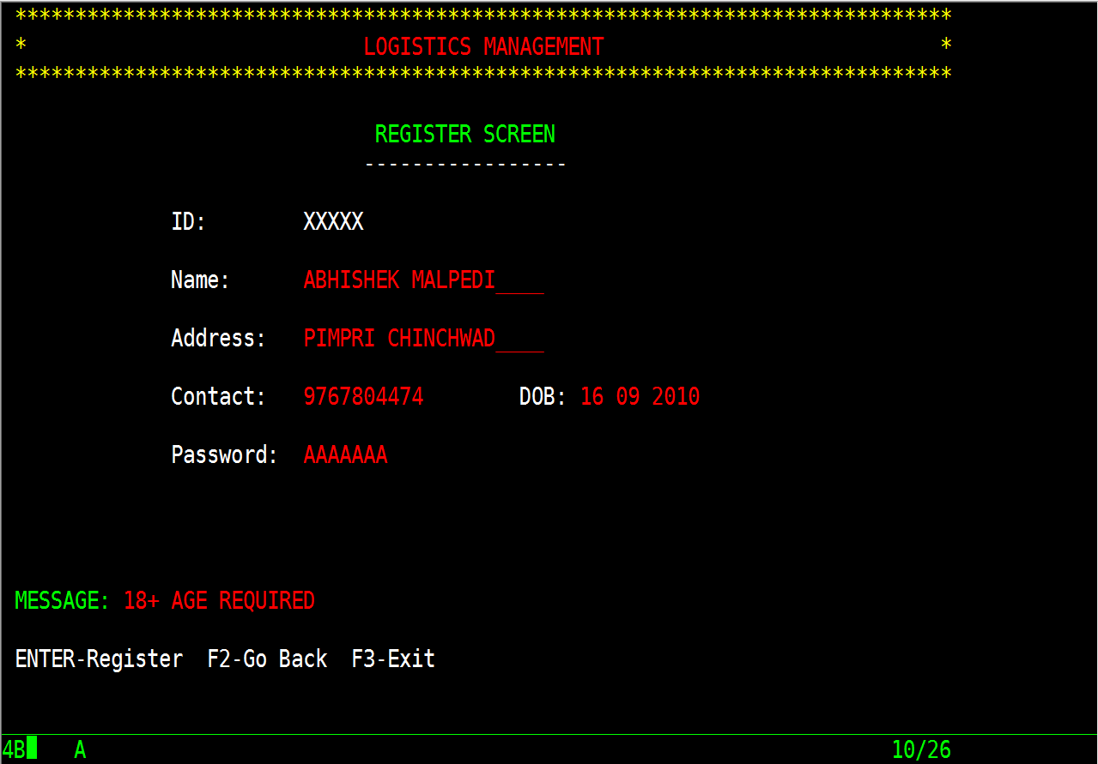
Test Case 6: Valid age
Expected result – Proceeding further only when user age is minimum of 18, else requesting user to enter valid date-of-birth in date-of-birth field
Actual result – Displaying proper message for invalid details
Result – PASS

Slide 30
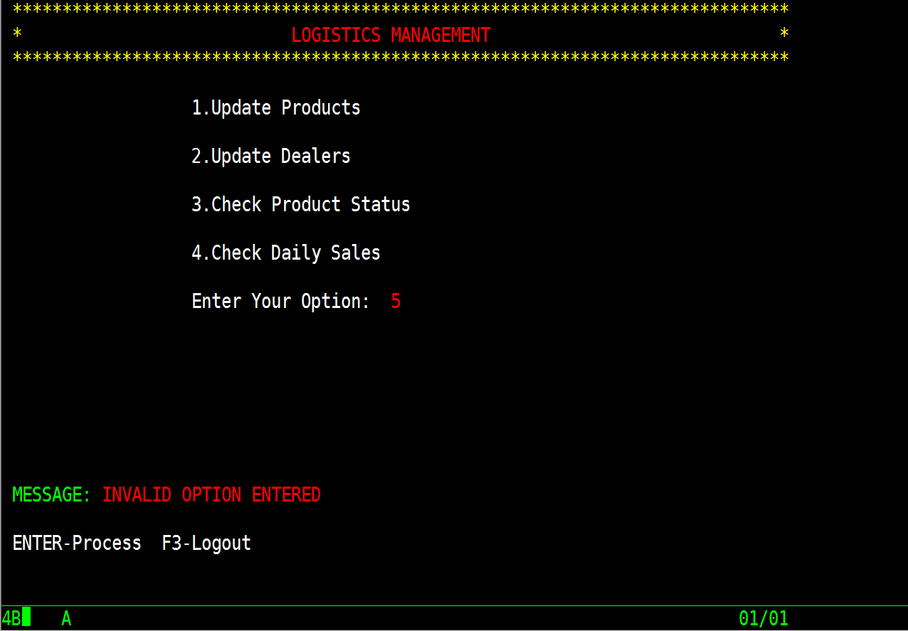
4. Admin Menu Screen
Test Case 1: Successful admin login
Expected result – To login successfully to admin account and show admin menu map
Actual result – Login successful and showing admin menu map
Result – PASS
Test Case 2: Enter proper option
Expected result – Ask user to enter valid option
Actual result – Displaying proper message regarding invalid option
Result – PASS

Slide 31
Test Case 3: Displaying respective map on valid selection
Expected result – To display valid map on selection of respective valid option
Actual result – Displaying valid map based on selection of option
Result – PASS

Slide 32
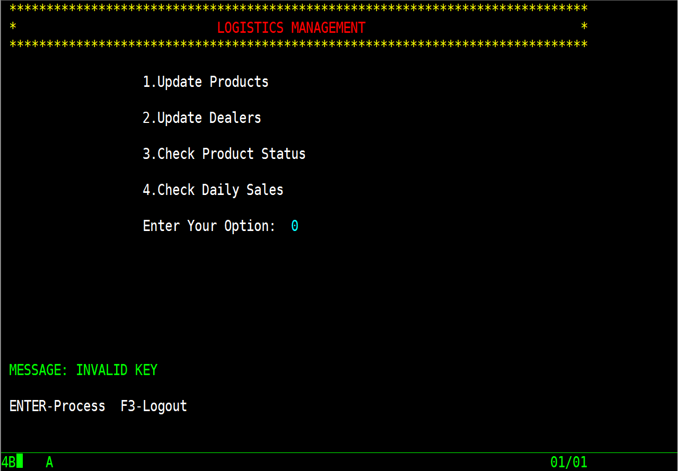
Test Case 4: Invalid AID-Key
Expected result – Display proper message if invalid aid-key is pressed
Actual result – Displaying proper message
Result – PASS

Slide 33
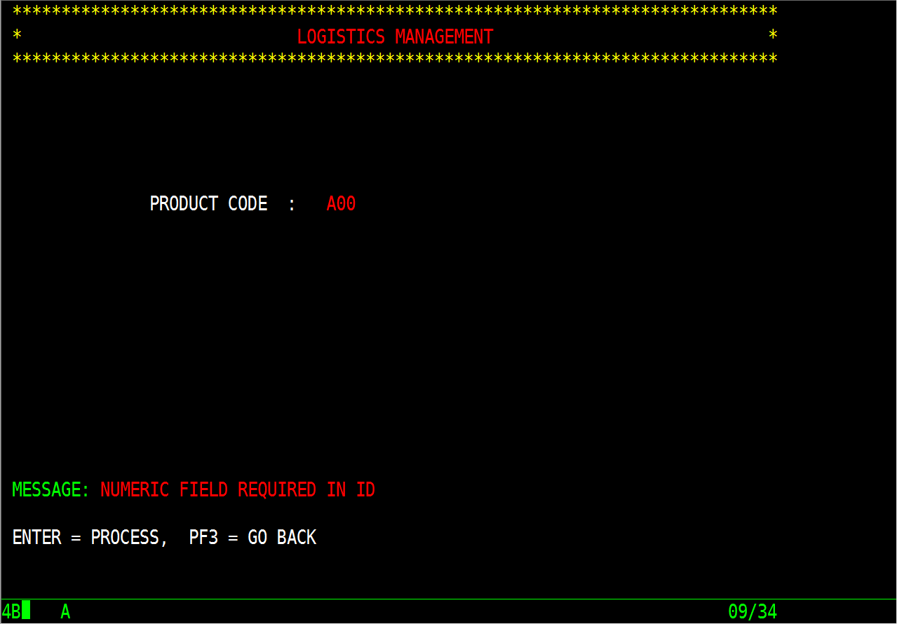
5. Product Key Screen
Test Case 1: Numeric data in field
Expected result – To accept numeric product ID and proceed further else show proper message to user
Actual result – Accepting numeric product ID and proceeding further
Result – PASS

Slide 34
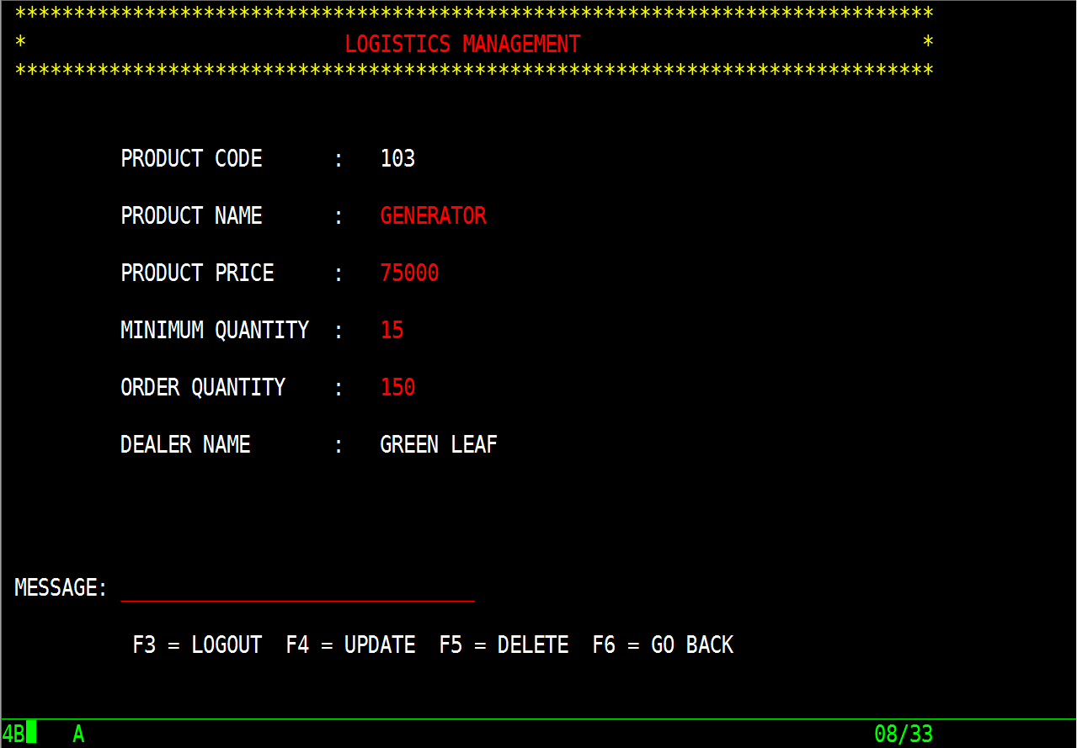
6. Product Details Screen
Test Case 1: Displaying details for existing product ID
Expected result – To display all details of existing product and allow admin to perform tasks
Actual result – Displaying all details
Result – PASS

Slide 35
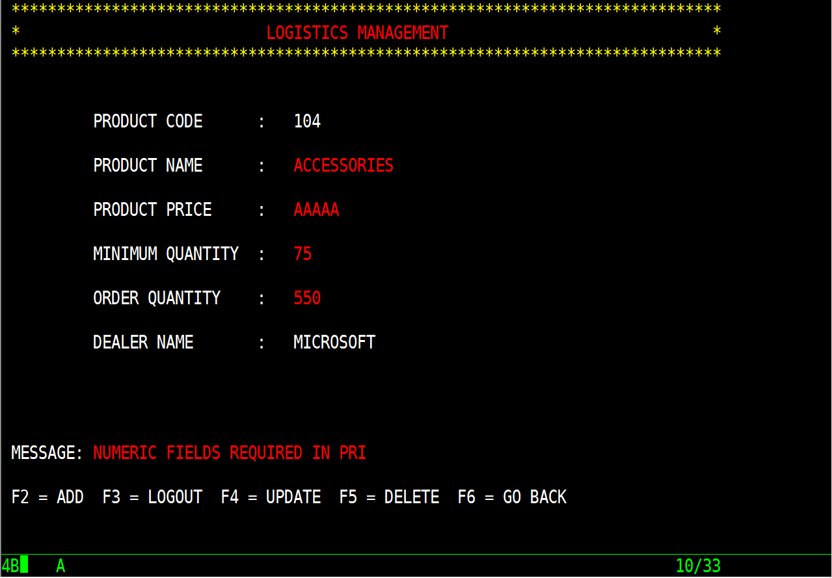
Test Case 2: Numeric fields
Expected result – To accept only numeric values in product price otherwise to show proper message
Actual result – Accepting numeric values in product price
Result – PASS

Slide 36
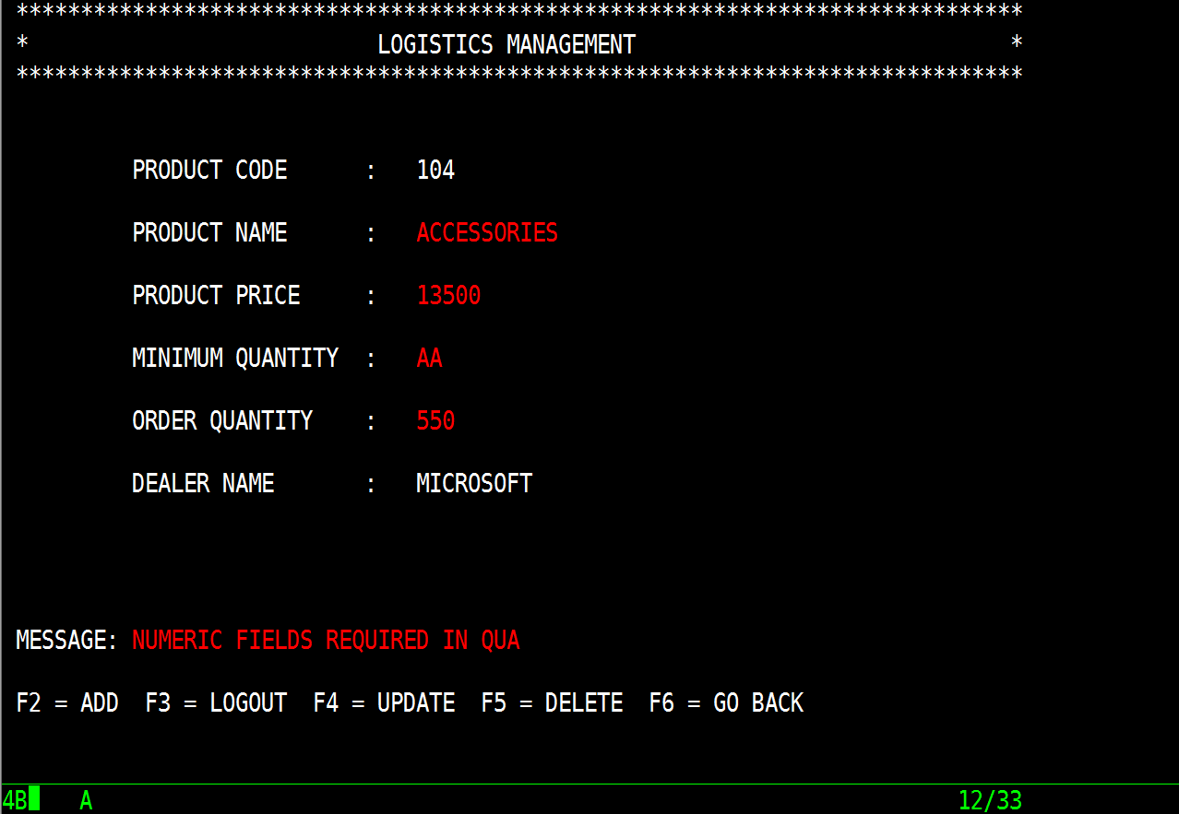
Test Case 3: Numeric fields
Expected result – To accept only numeric values in product quantity otherwise to show proper message
Actual result – Accepting numeric values in product quantity
Result – PASS

Slide 37
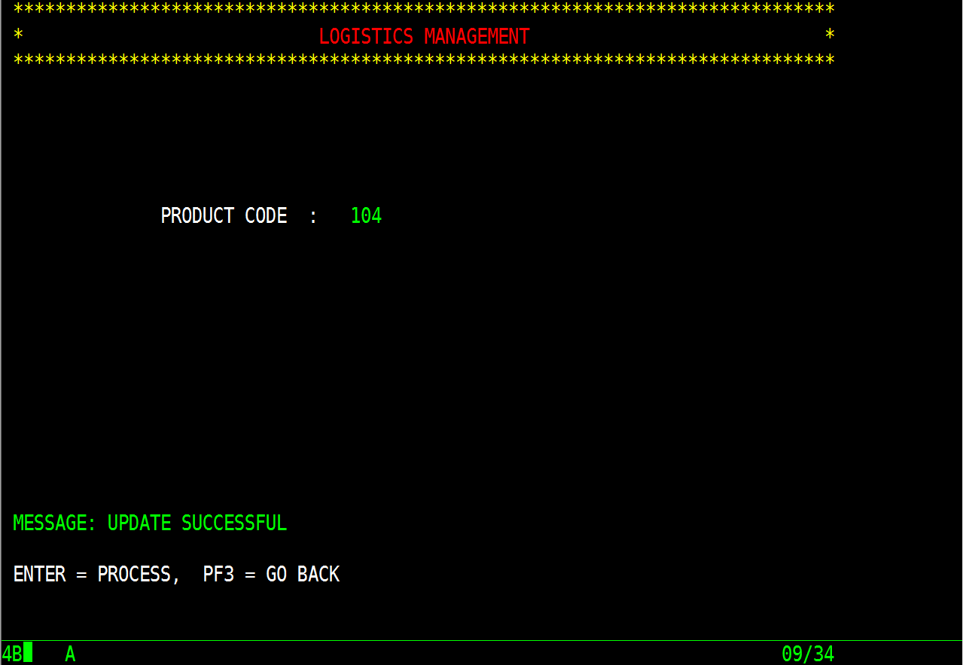
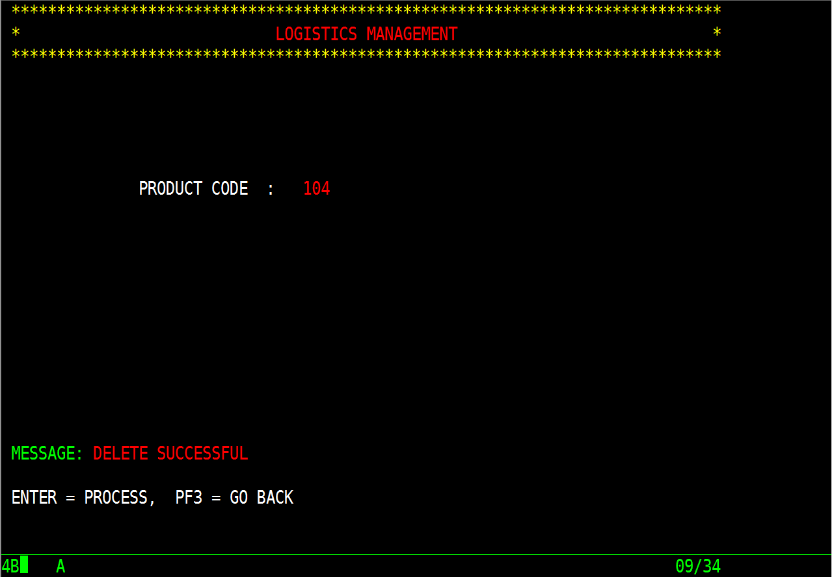
Test Case 5: Updation
Expected result – To update or delete product
Actual result – Updating product on respective aid-key and deleting product on respective aid-key
Result – PASS

Slide 38
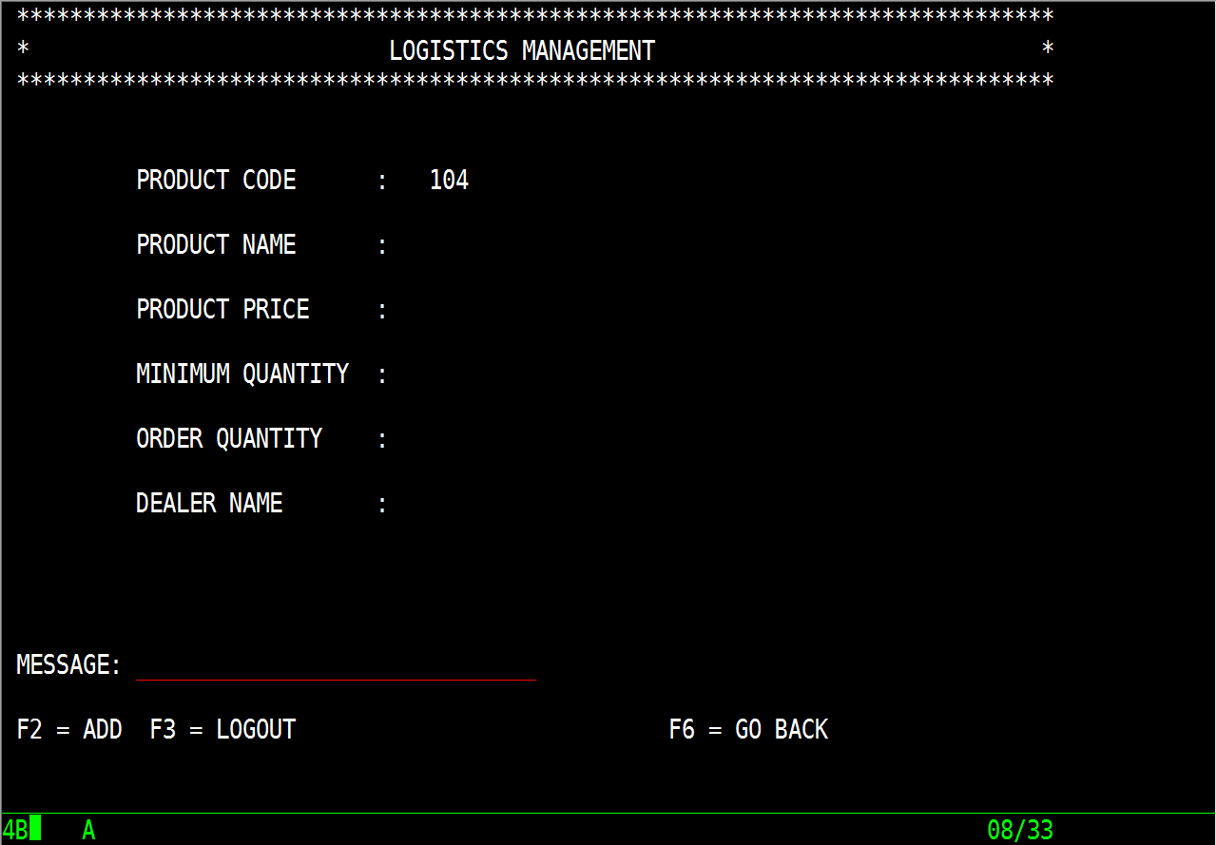
Test Case 6: Displaying blank map for new product ID
Expected result – To display blank map to add new product and allow to perform tasks
Actual result – Displaying blank map
Result – PASS

Slide 39
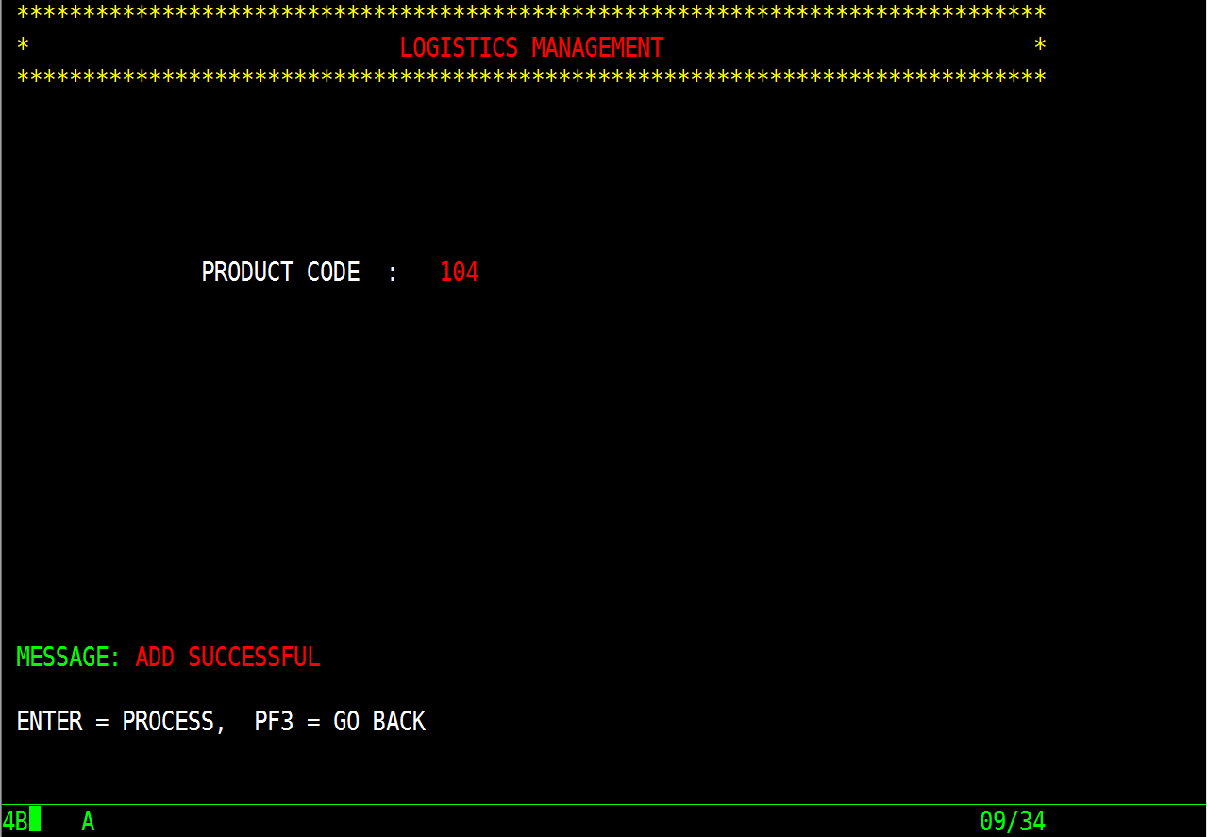
Test Case 7: Updation
Expected result – To add new product
Actual result – Adding a new product on successful validations
Result – PASS

Slide 40
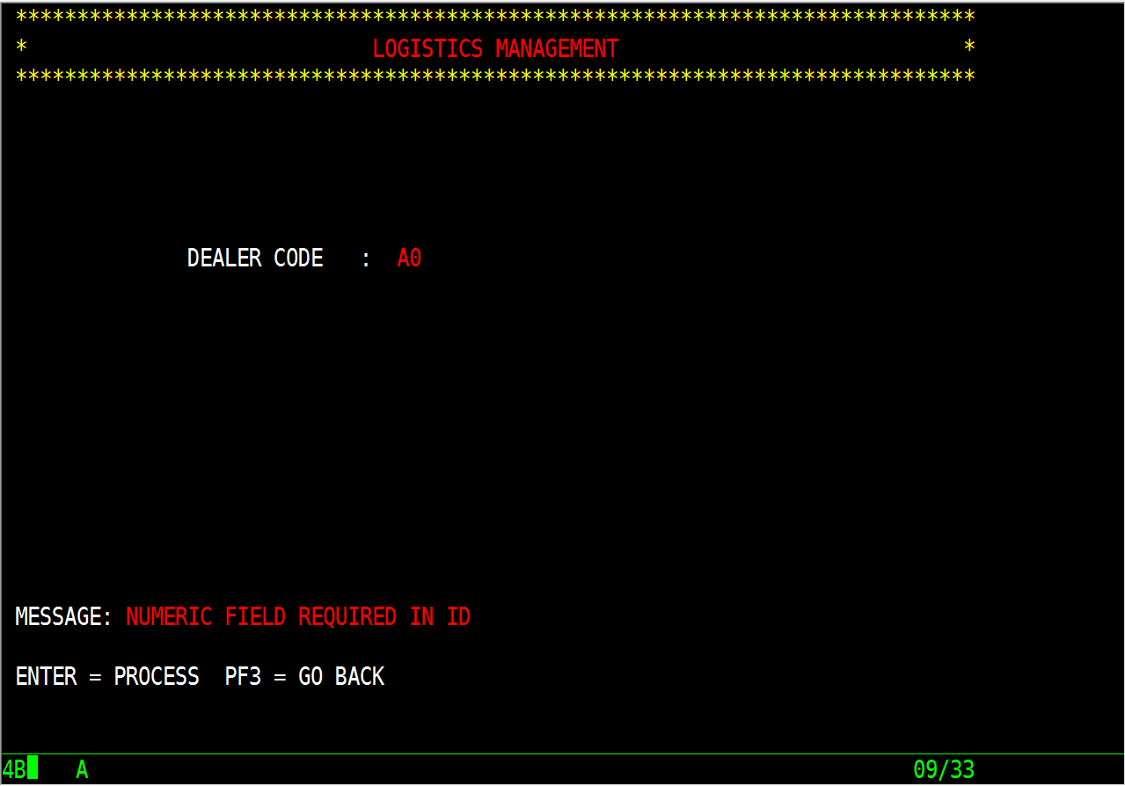
7. Dealer Key Screen
Test Case 1: Numeric data in field
Expected result – To accept numeric dealer ID and proceed further else show proper message to user
Actual result – Accepting numeric dealer ID and proceeding further
Result – PASS

Slide 41
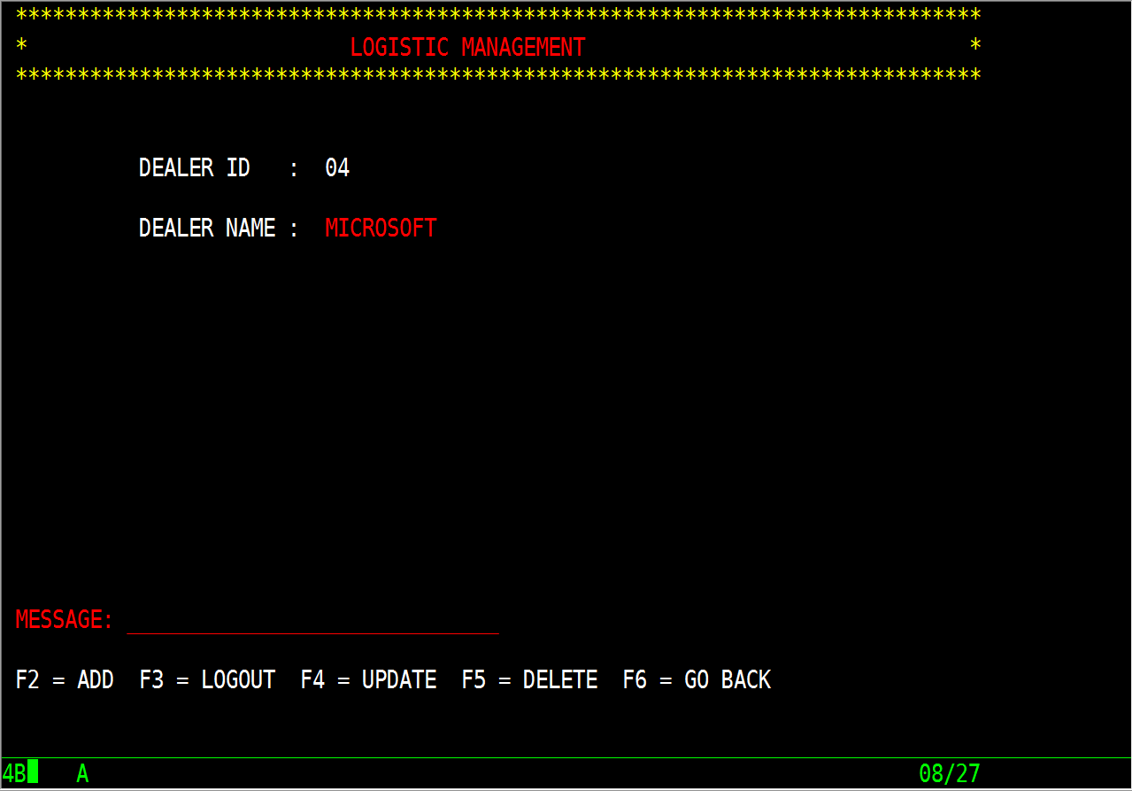
8. Dealer Details Screen
Test Case 1: Displaying details for existing dealer ID
Expected result – To display all details of existing dealer and allow admin to perform tasks
Actual result – Displaying all details
Result – PASS

Slide 42
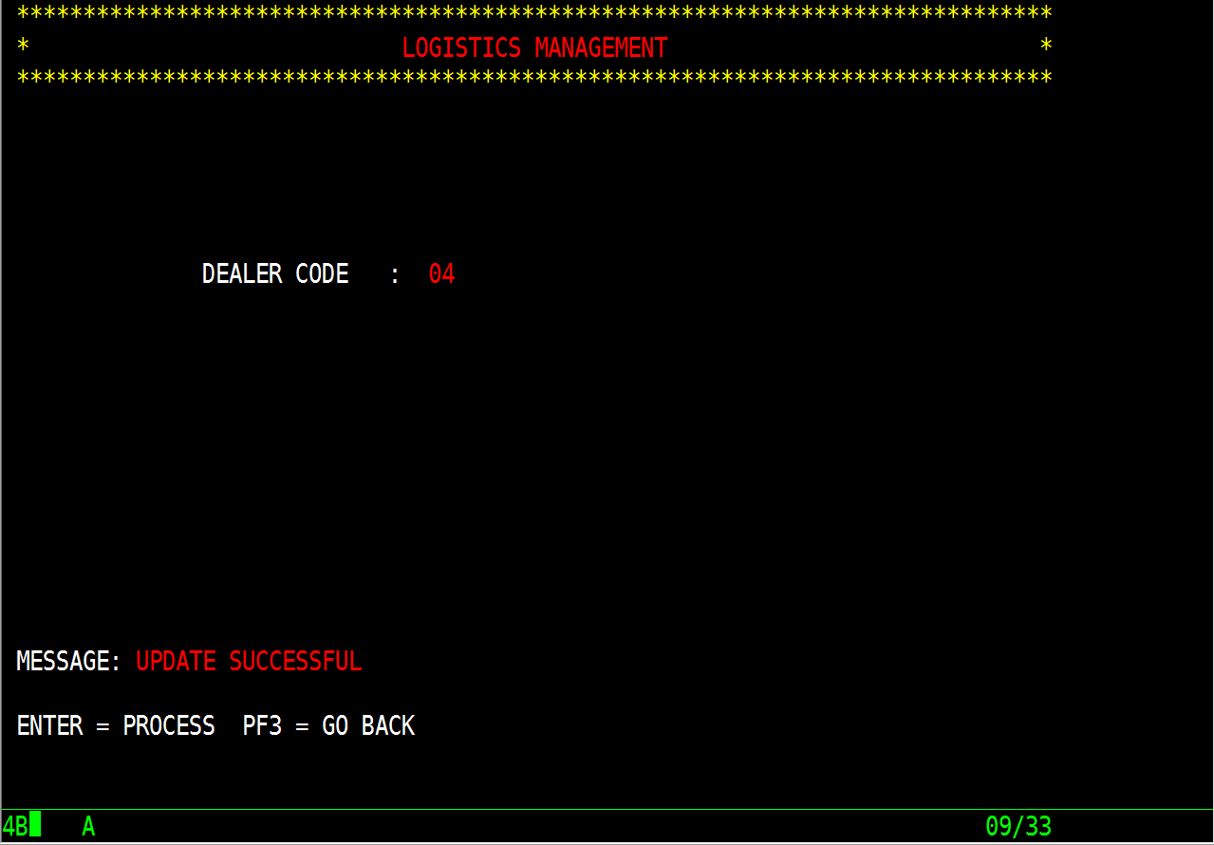
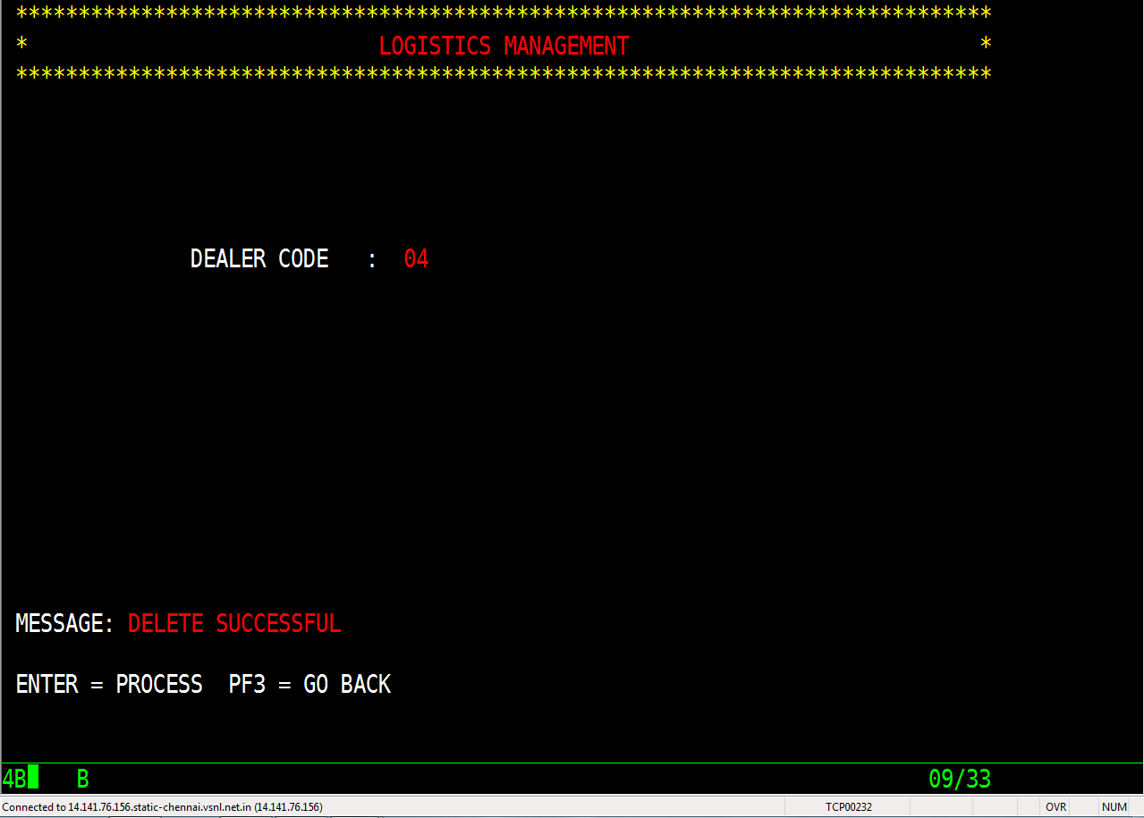
Test Case 3: Updation
Expected result – To update or delete product
Actual result – Updating product on respective aid-key and deleting product on respective aid-key
Result – PASS

Slide 43
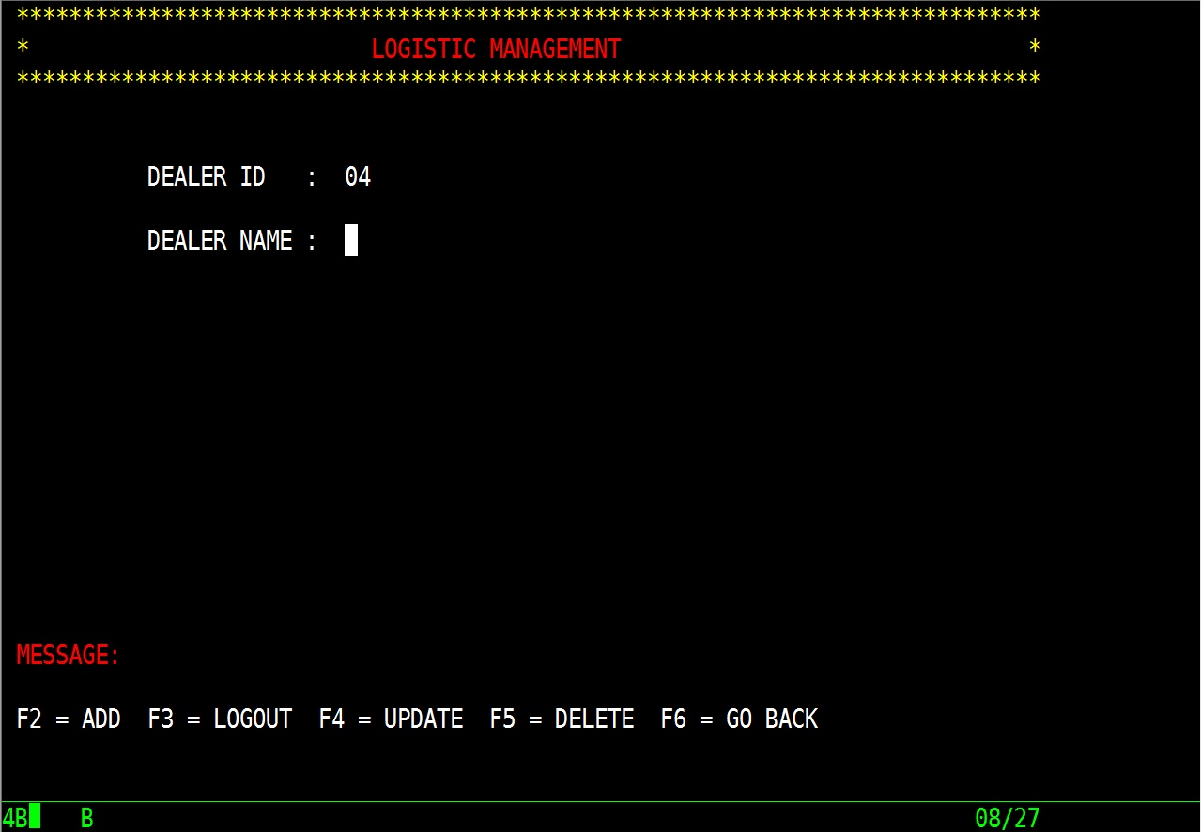
Test Case 4: Displaying blank map for new product ID
Expected result – To display blank map to add new product and allow to perform tasks
Actual result – Displaying blank map
Result – PASS

Slide 44
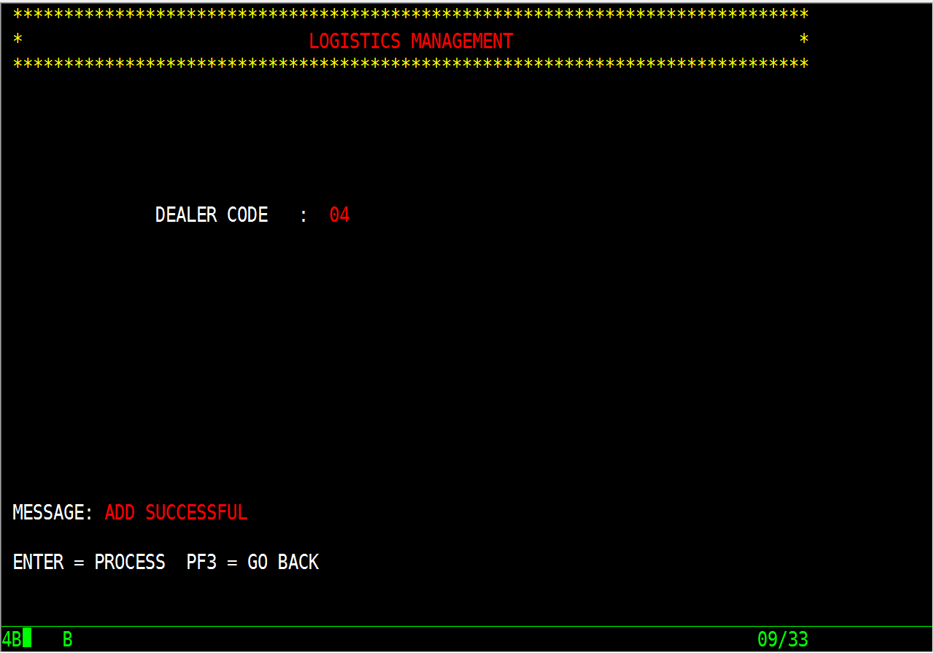
Test Case 5: Updation
Expected result – To add new dealer
Actual result – Adding a new dealer on successful validations
Result – PASS

Slide 45
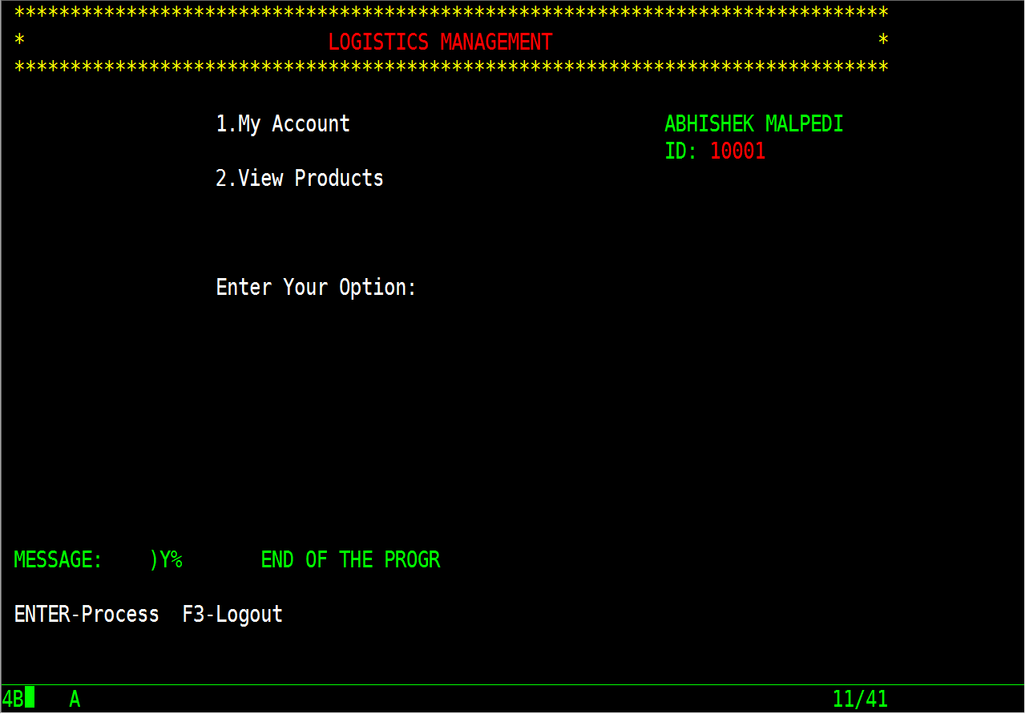
9. User Menu Screen
Test Case 1: Successful login
Expected result – To display user ID and name on successful login
Actual result – Displaying details of user and login is successful
Result – PASS

Slide 46
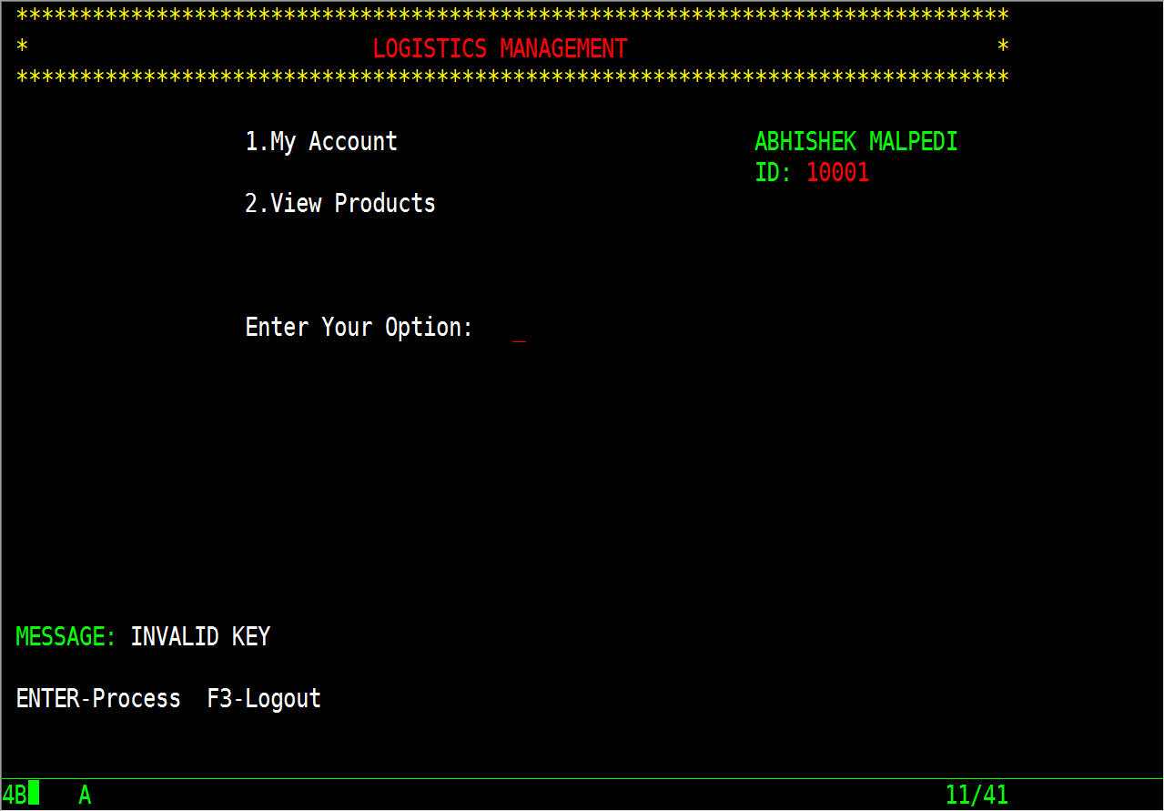
Test Case 2: Invalid option
Expected result – To display proper message if invalid option or invalid aid-key is selected
Actual result – Displaying proper message to user
Result – PASS

Slide 47
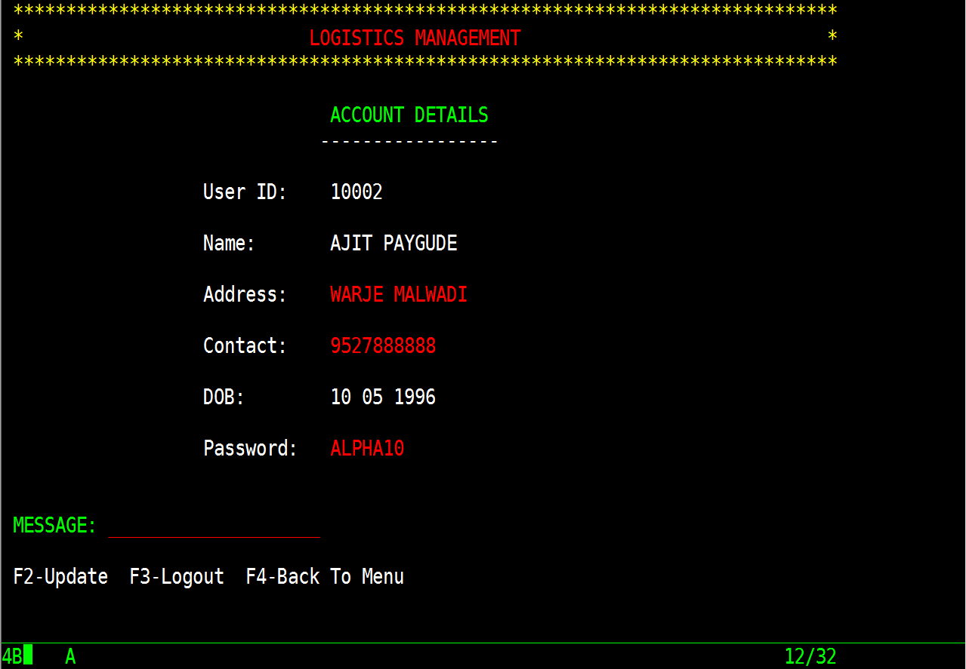
10. My account screen
Test Case 1: Displaying user details
Expected result – To display all details of existing user and allow user to update details.
Actual result – Displaying all details of user, able to update successfully but not able to go back to user menu screen.
Result – Partial

Slide 48
11. View Products Screen
Test Case 1: Displaying products
Expected result – To display all details of existing products and allow user to select product.
Actual result – Displaying all details of products but not able to select products
Result – Fail

Slide 49
11. Bill Screen
Test Case 1: To generate Bill
Expected result – To accept selected product and generate bill.
Actual result – Garbage values. Not able to generate bill
Result – Fail

Slide 50
Self Review
Program ID | P24AP01 | P24AP02 | P24AP03 | P24AP04 | P24AP05 | P24AP06
Coding Standards
Indentation
Convention
Validations
Initial cursor |  |  |  | X
Database handling | NA |  |  | NA |  | NA
Pseudo conversation
Flow

Slide 51
Program ID | P24AP07 | P24AP08 | P24AP09 | PROG07 | PROG08
Coding Standards
Indentation
Convention
Validations |  | NA |  | NA | NA
Initial cursor |  |  |  | NA | NA
Database handling
Pseudo conversation |  |  |  | NA | NA
Flow |  | X

Slide 52
Peer Review – By G3
1. P24AP01 - Coding standards maintained, well alignment
2. P24AP02 – Coding standards maintained, well alignment
3. P24AP03 – Coding standards maintained, well alignment
4. P24AP04 – Coding standards maintained, well alignment,
initial cursor not working
5. P24AP05 – Coding standards maintained, well alignment
6. P24AP06 – Coding standards maintained, well alignment
7. P24AP07 – Coding standards maintained, well alignment,
XCTL not working
8. P24AP08 – Partially working, cannot generate bill
9. P24AP09 – Coding standards maintained, well alignment
10. PROG07 – Comments not given
11. PROG08 – Comments not given

Slide 53
Thank You

